Slide 1


Data Analysis of Amazon Watch Products
This presentation explores a data analysis project focused on analyzing Amazon watch product data. We'll cover web scraping, data cleaning, SQL database integration, and Power BI visualization. Our goal is to extract valuable insights from this data for strategic decision-making.
DA
by Dharani A

Slide 2
Introduction to Web Scraping
Manual Data Extraction
Real-Time Data Access
Manual data extraction is a time-consuming process of gathering data manually from websites. In contrast, web scraping automates this, offering real-time data by collecting current information programmatically.
Real-time data access allows users to retrieve the most current and continuously updated information directly from a source. It ensures that decisions are based on live data, providing timely insights.

Slide 3
Extracting Data from Amazon Watch Products
Target Website
Web Scraping Tools
Data Points
Amazon's website was selected as the data source due to its comprehensive collection of watch products.
The Beautiful Soup library in Python was used for parsing and extracting HTML data from Amazon's website.
Key data points extracted included product name, price, brand, rating, reviews, and discount.

Slide 4

Data Cleaning and Transformation in Excel
Splitting a Column
Handling Missing Values
Split means dividing a single column's data into multiple columns based on a delimiter (like commas or spaces). This is often done using the "Text to Columns" feature for easier data management.
Missing values were addressed by either replacing them with the average or deleting rows with incomplete data.

Slide 5
Connecting Python to SQL Database
Python Libraries
Database Credentials
Cursor Object
Python libraries like `pandas` and ’mysql connector` facilitate the connection to SQL databases.
Connect to the SQL database using credentials such as server address, username, and password.
The cursor object in Python allows you to execute SQL queries and interact with the database.

Slide 6

Importing Data into SQL Database
1
Create Table
The first step is to create a new table in the SQL database to store the scraped Amazon watch data.
2
Insert Data
Use Python to insert the cleaned and transformed data from the Excel spreadsheet into the newly created SQL table.
3
Verify Data
After inserting the data, run a SQL query to verify that the data has been imported correctly.

Slide 7
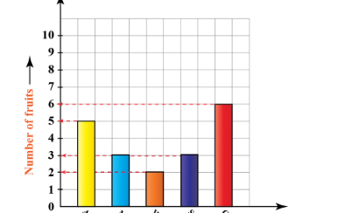
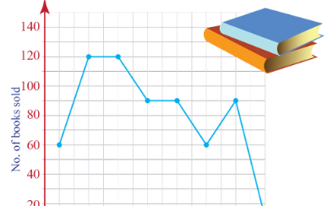
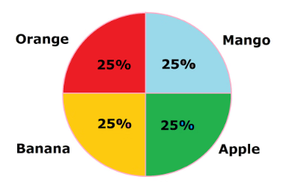
Visualizing Data in Power BI
Bar Charts
Line Charts
Pie Charts
Compare categories using bars of different lengths, ideal for showing relative values and trends.
Track data points over time, effective for highlighting patterns and trends in data.
Illustrate proportions of a whole, useful for comparing parts to the whole.

Slide 8



Insights and Findings
Price Trends
1
Brands like Fossil are priced higher, while Sonata offers more affordable options, reflecting a clear price segmentation across brands.
Customer Sentiment
2
Brands with higher prices, like Casio and Fossil, also tend to receive better customer ratings, showing a link between price and customer satisfaction.
Discount Patterns
3
Fossil offers the largest discounts, indicating an aggressive pricing strategy to appeal to budget-conscious buyers.

Slide 9

Challenges and Lessons Learned
Data Consistency
Web Scraping Complexity
Ensuring data consistency across different sources was a challenge, requiring careful cleaning and transformation.
Navigating website changes and implementing robust scraping techniques to avoid errors was crucial.
Data Visualization
Project Management
Selecting appropriate visualizations and creating an engaging dashboard for presenting key insights was essential.
Effective project management techniques were needed to stay organized, track progress, and meet deadlines.

